Slide 1

FOV
Monitor Plane
Projection Plane

Slide 2
Half - Projection Plane
Half - Monitor Plane
Half - FOV
D
1 unit (Distance from monitor to eyes)
Unknown distance
Z units (Total distance from projection to eyes

Slide 3
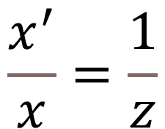


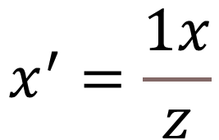

E
$$\frac{BC}{DE}=\frac{AB}{AD}$$
The ratio between the bases and sides of similar triangles is always the same
Sides
Bases
$$\frac{x^{′}}{x}=\frac{1}{z}$$
$$\frac{x^{′}}{x}=\frac{1}{z}$$
C
X
X’
$$x^{′}=\frac{1x}{z}$$
$$x^{′}=\frac{x}{z}$$
A
D
B
1
Z
This has an important implication. Consider a large 'Z' in the equation X' = X / Z . This means that for a larger Z, the resulting X' will be smaller. In a 3D scenario, this translates into objects that are farther away will appear smaller. The exact effect desired
And the same idea applies to the 'Y' axis.
Therefore:
X' = X/Z
Y' = Y/Z

